Slide 1

CSE 473: Pattern Recognition

Slide 2
Unsupervised Learning:
Clustering

Slide 3
Reassignment of vectors
Why necessary?
The problem of sensitivity to the order of data presentation:
“A vector x may have been assigned to a cluster C_{i} at the current stage but another cluster C_{j} may be formed at a later stage that lies closer to x”

Slide 4
  A simple reassignment procedure
    For i=1 to N
      Find C_{j} such that d(x_{i},C_{j})=min_{k=1,…,m}d(x_{i},C_{k})
      Set b(i)=j \{ b(i) is the index of the cluster that lies closet to x_{i} \}
    End {for}
    For j=1 to m
      Set C_{j}={x_{i}∈X: b(i)=j}
      If necessary, update representatives
    End {for}

Slide 5
k-means Clustering
Partitional clustering approach
Each cluster is associated with a centroid (center point)
Each point is assigned to the cluster with the closest centroid
Number of clusters, k, must be specified
The basic algorithm is very simple

Slide 6

k-means Clustering
Partitional clustering approach
Each cluster is associated with a centroid (center point)
Each point is assigned to the cluster with the closest centroid
Number of clusters, k, must be specified
The basic algorithm is very simple

Slide 7
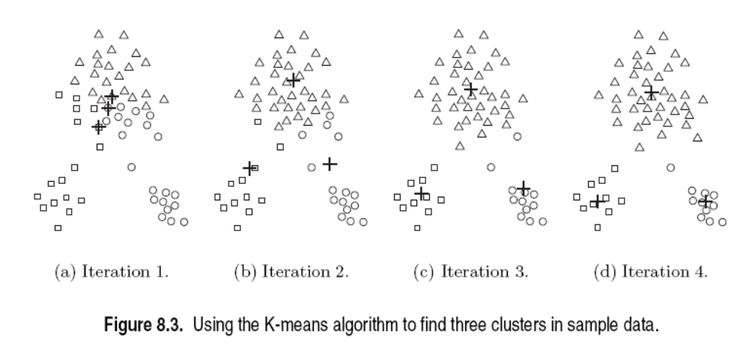
k-means Clustering
Initial centroids are often chosen randomly.
  Clusters produced vary from one run to another.

Slide 8
k-means Clustering
Points are distributed to the closest centroid.
‘Closeness’ is measured by Euclidean distance, cosine similarity, correlation, etc.

Slide 9
k-means Clustering
centroid is (typically) the mean of the points in the cluster.

Slide 10
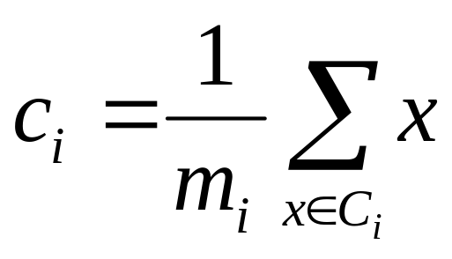
K-means Clustering
centroid is (typically) the mean of the points in the cluster.

Slide 11
k-means Clustering
k-means will converge for common similarity measures

Slide 12
k-means Clustering
Most of the convergence happens in the first few iterations.
  Often the stopping condition is changed to ‘Until relatively few points change clusters’

Slide 13
k-means Clustering

Slide 14
k-means Clustering
k-means try to optimize an objective function

Slide 15
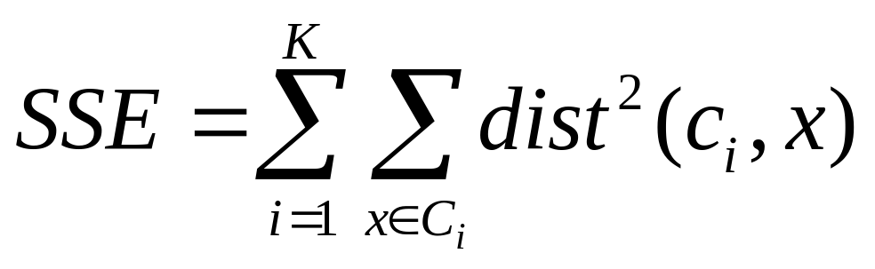
k-means Clustering
k-means try to optimize an objective function

Slide 16
Evaluating k-means Clusters
  Given two clusterings, choose the one with the smallest error
  An easy way to reduce SSE is to increase k
    A good clustering with smaller k can have a lower SSE than a poor clustering with higher k

Slide 17
k-means Clustering – Complexity
Storage Complexity is O ((m+k)n)
  m = number of points
  k = number of clusters
  n = number of attributes
Time Complexity is O(I* k * m *n )
  I = number of iterations

Slide 18



k-means may lead to suboptimal solution
Original Points
Optimal Clustering
Sub-optimal Clustering

Slide 19






Importance of Choosing Initial Centroids

Slide 20
Importance of Choosing Initial Centroids
find optimal SSE, although initial centroids are from one natural cluster

Slide 21
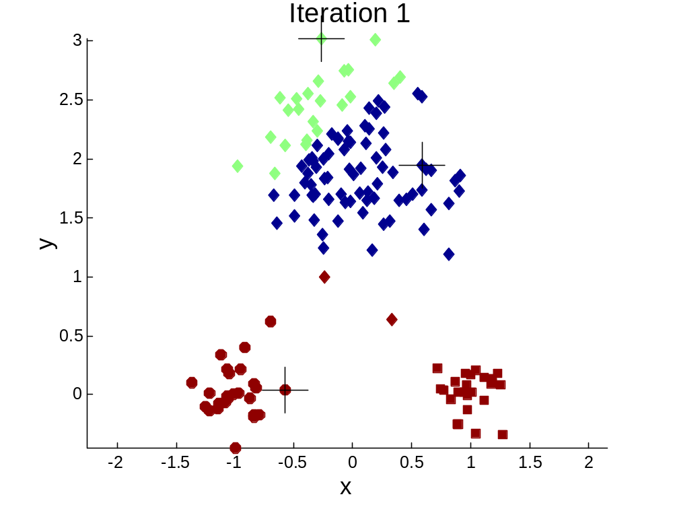


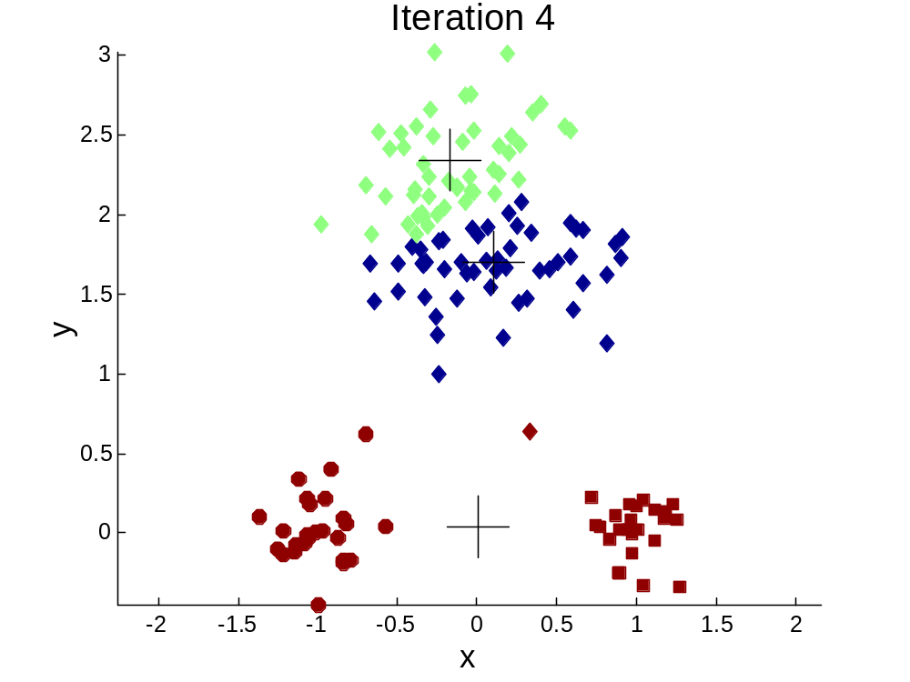
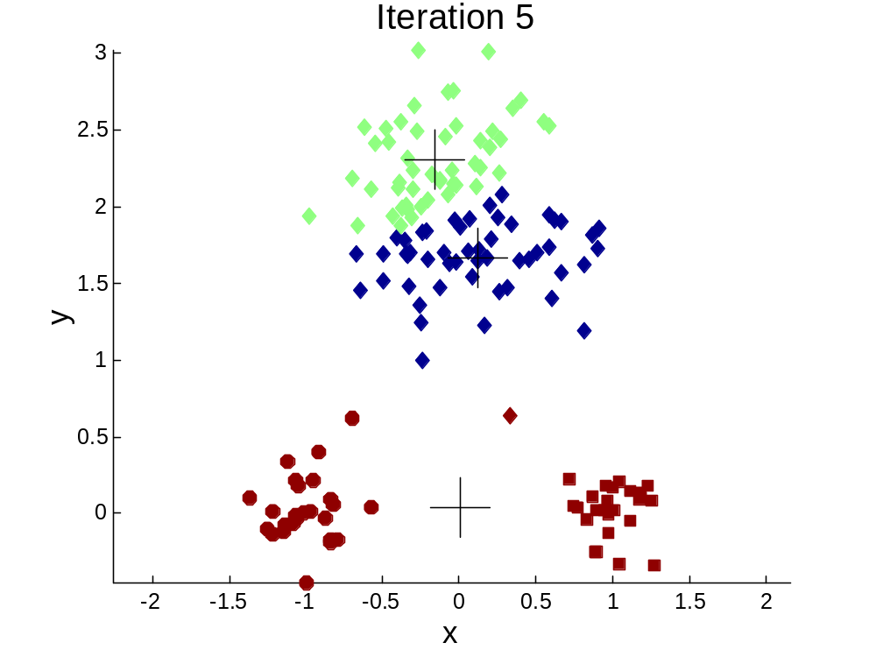
Importance of Choosing Initial Centroids …

Slide 22
Importance of Choosing Initial Centroids …
cannot find optimal SSE

Slide 23
Problems with Selecting Initial Points
If there are k ‘real’ clusters then the chance of selecting one centroid from each cluster is small.
  Chance is relatively small when k is large
  Consider an example of five pairs of clusters

Slide 24
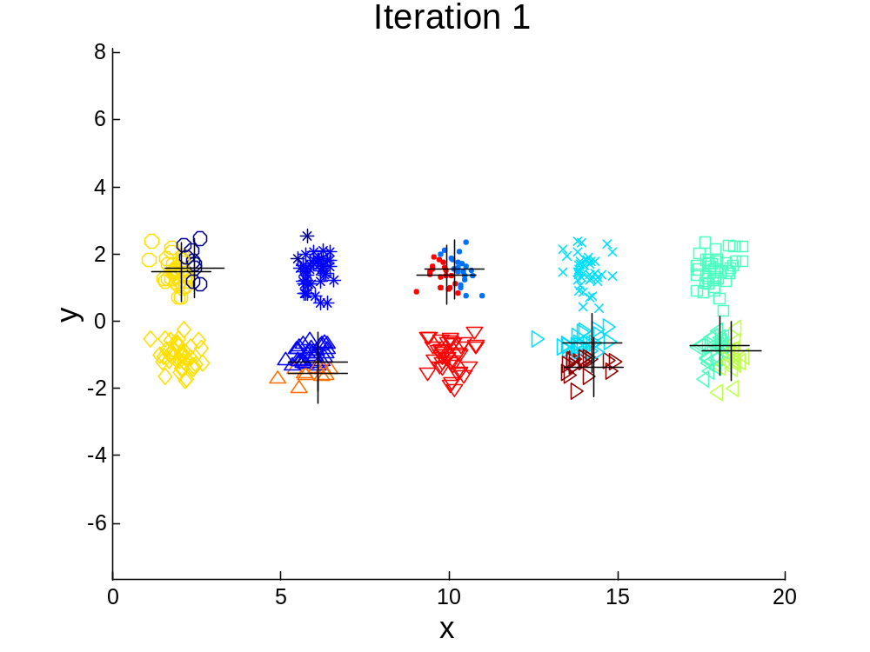
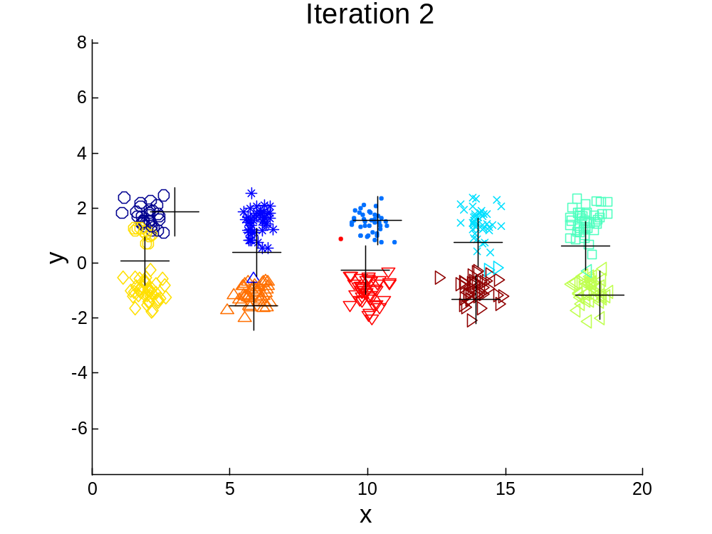
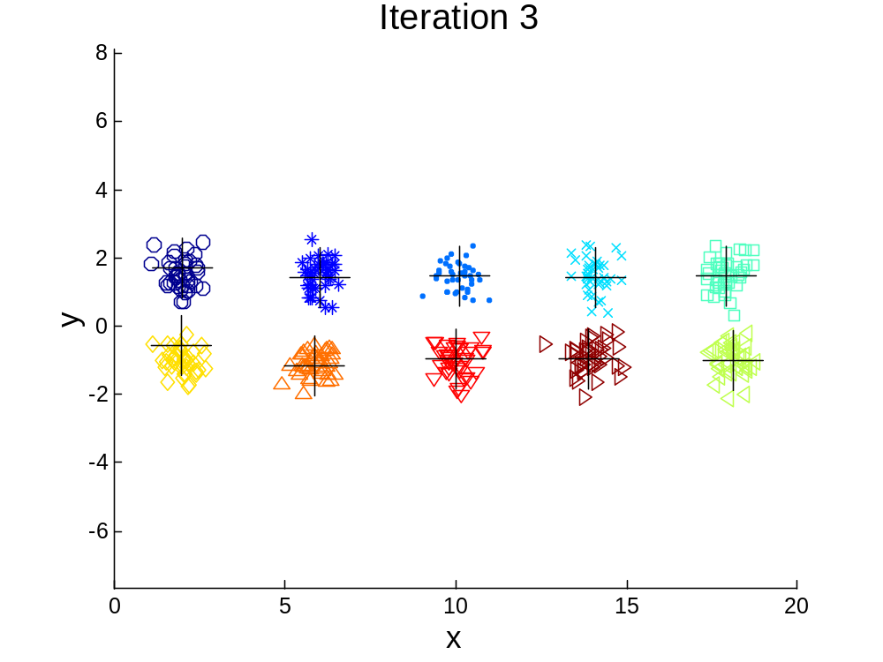

10 Clusters Example
Starting with two initial centroids in one cluster of each pair of clusters

Slide 25
10 Clusters Example
Starting with two initial centroids in one cluster of each pair of clusters

Slide 26
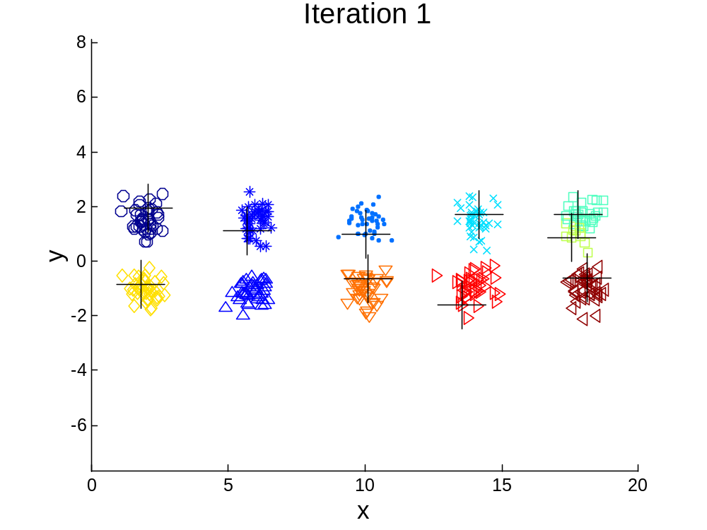



10 Clusters Example
Starting with some pairs of clusters having three initial centroids, while other have only one.

Slide 27
10 Clusters Example
Starting with some pairs of clusters having three initial centroids, while other have only one.

Slide 28
Solutions to Initial Centroids Problem
Multiple runs
  Helps, but probability is not on your side
Sample and use hierarchical clustering to determine initial centroids

Slide 29
Solutions to Initial Centroids Problem
Select more than k initial centroids and then select among these initial centroids
  Select most widely separated
    can select outliers, too
Post-processing
Bisecting K-means
  Not as susceptible to initialization issues

Slide 30
Additional Issues: Handling Empty Clusters
Basic k-means algorithm can yield empty clusters
Several strategies
  Choose the point that contributes most to SSE
  Choose a point from the cluster with the highest SSE
  If there are several empty clusters, the above can be repeated several times.

Slide 31
Updating Centroids Incrementally
In the basic k-means algorithm, centroids are updated after all points are assigned to a centroid
An alternative is to update the centroids after each assignment (incremental approach)
  Each assignment updates zero or two centroids
  More expensive
  Introduces an order dependency!
  Never gets an empty cluster

Slide 32
Pre-processing and Post-processing
Pre-processing
  Normalize the data
  Eliminate outliers
Post-processing
  Eliminate small clusters that may represent outliers
  Split ‘loose’ clusters, i.e., clusters with relatively high SSE
  Merge clusters that are ‘close’ and that have relatively low SSE

